Slide 1

Diagnostic Immobilier

Slide 2







Slide 3




Slide 4


Slide 5
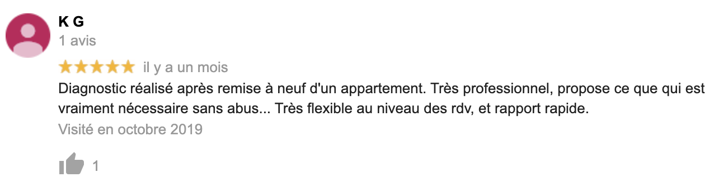


Slide 6


Slide 7


Slide 8


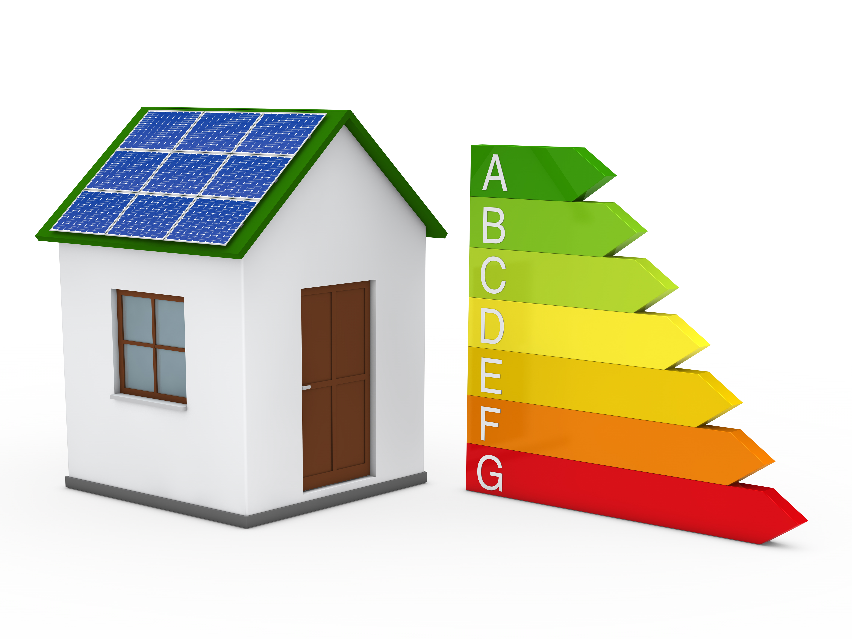


Slide 9


